Slide 1
Convolutional Codes & Viterbi Algorithm
Prepared by
Prof. Hitesh Dholakiya
Modified by
Rifat Rahman
Assistant Professor
Institute of Appropriate Technology, BUET

Slide 2
Convolutional Code
A convolutional code is a type of channel coding (error control coding) technique used in digital communication systems to detect and correct errors introduced by noise in the channel.
Unlike block codes (e.g., Hamming code), convolutional codes process data continuously, not in fixed-size blocks.
Input data bits are passed through a shift register (memory element)
Output bits are generated using modulo-2 addition (XOR)
Output depends on: Current input bit and Previous input bits (memory). So, the encoder has memory.
Because the output sequence is the convolution of the input sequence with the generator sequence (in modulo-2 arithmetic).

Slide 3
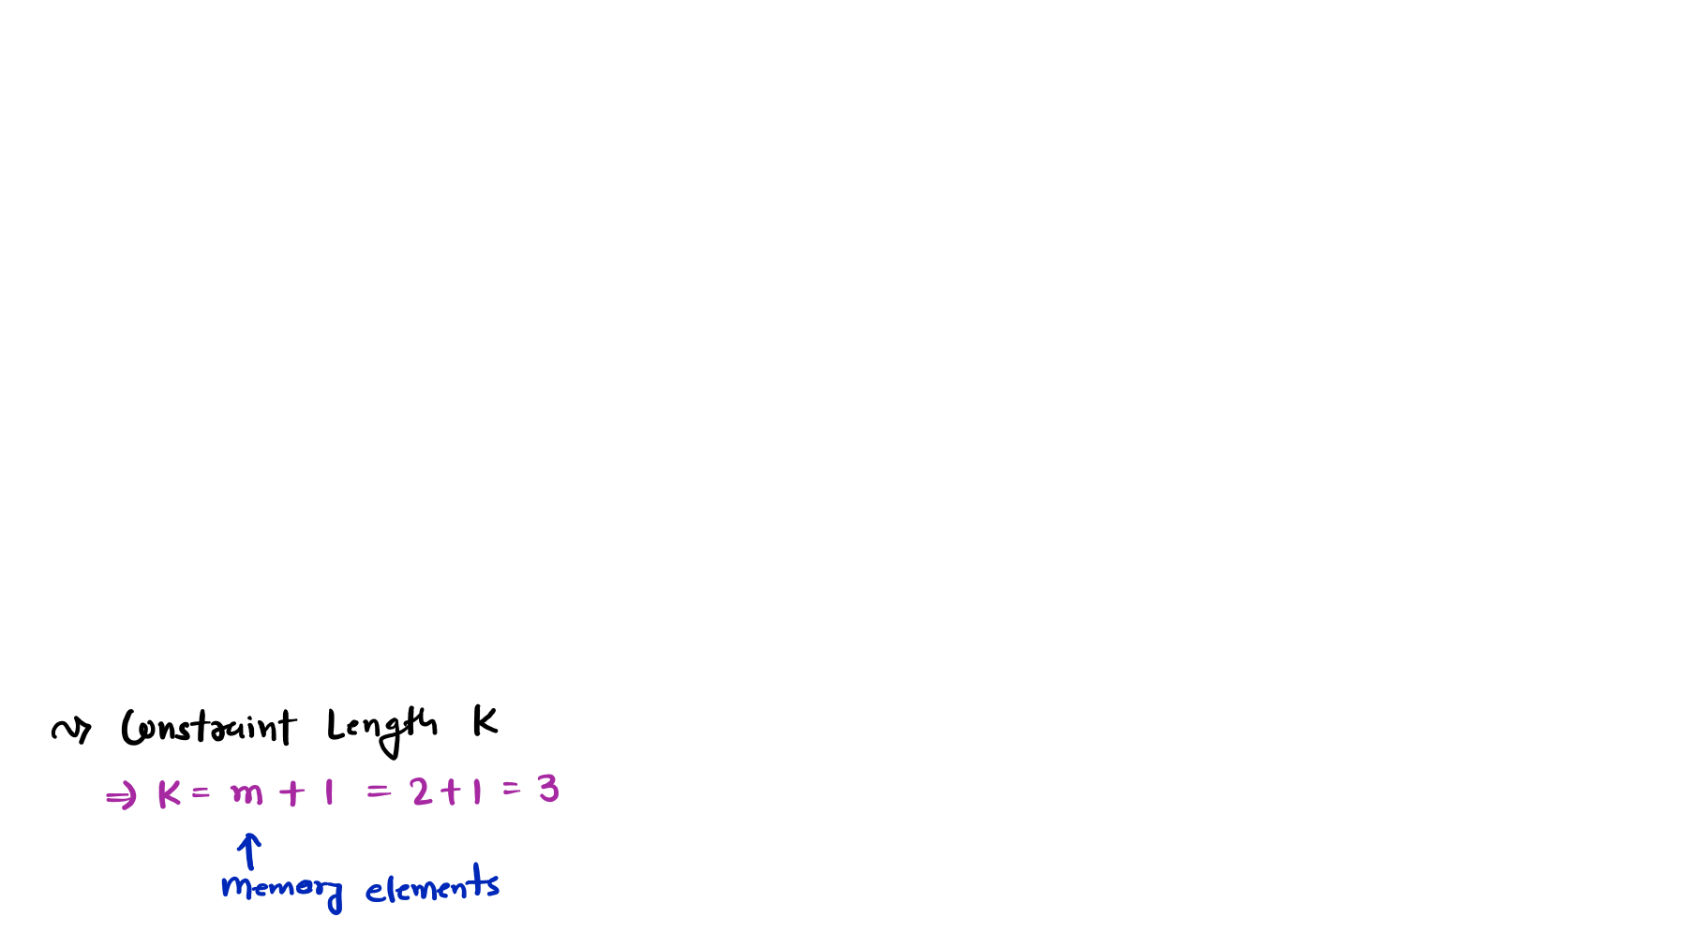








Convolutional Code
Example: The Convolutional Encoder is given in the figure. Calculate the following
parameters:
Constraint Length K
Code Dimensions (n, k)
Code Representation (n, k, K)
Code Rate r
States
Output with Message [1 1 0]
Code Tree
Code Trellis
State Diagram
X1
Switch
M0
M1
M2
FF1
FF2
Message Input
Output
X2
In this figure,
The generator sequence for output X1 is, g1 = (1,1,1)
The generator sequence for output X2 is, g2 = (1,0,1)

Slide 4
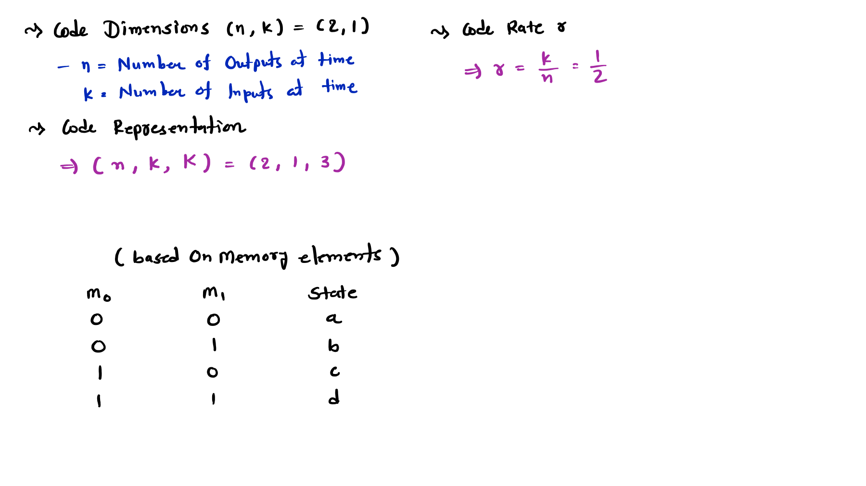
States

Slide 5
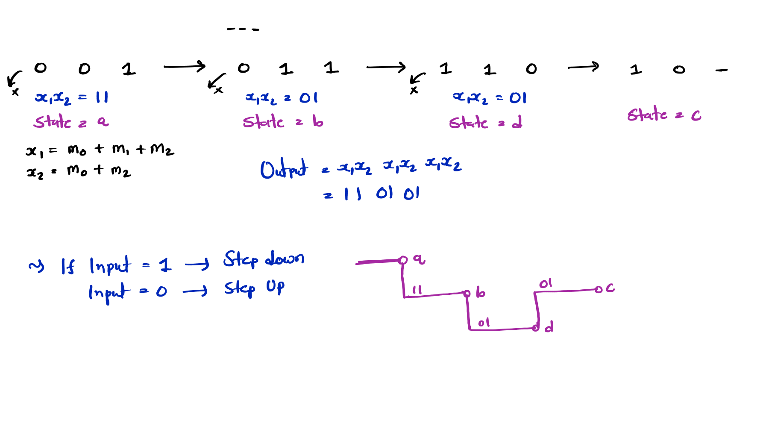
Output with Message [1 1 0]
M0 M1 M2 M0
M1 M2
M0 M1 M2
M0 M1 M2
Code Tree

Slide 6
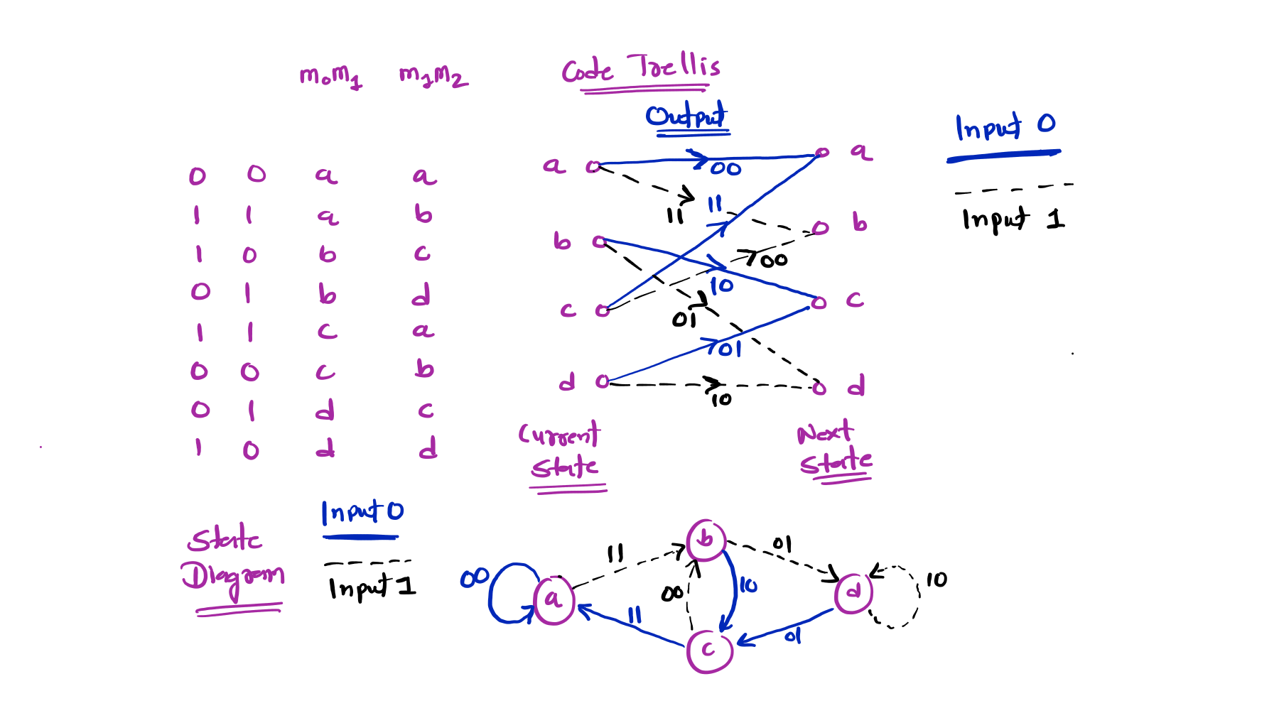
Code Trellis and State Diagram
M0 | M1 | M2 | X1 | X2 | Current State | Next State
0 | 0 | 0
0 | 0 | 1
0 | 1 | 0
0 | 1 | 1
1 | 0 | 0
1 | 0 | 1
1 | 1 | 0
1 | 1 | 1

Slide 7
Viterbi Algorithm
Outlines
Basics of Viterbi Algorithm
Objective of Viterbi Algorithm
Process of Viterbi Algorithm
Example of Viterbi Algorithm

Slide 8
Basics of Viterbi Algorithm
It is a maximum-likelihood decoding method for convolutional codes.
A trellis diagram is used to decode the received sequence.
Objective of Viterbi Algorithm
To find the most likely transmitted bit sequence by selecting the path through the trellis with the minimum path metric (distance from the received sequence).
Process of Viterbi Algorithm
The following steps are used to apply the Viterbi Algorithm:
Construct the trellis diagram from the convolutional encoder.
Initialize path metrics (usually zero for the starting state and infinity for others).
Compute branch metrics by comparing the received sequence with expected outputs.
Update path metrics for each state (Add–Compare–Select operation).
Store survivor paths for each state.
Trace back through the trellis to obtain the decoded sequence.
Select the path with minimum total metric as the most likely transmitted sequence.

Slide 9
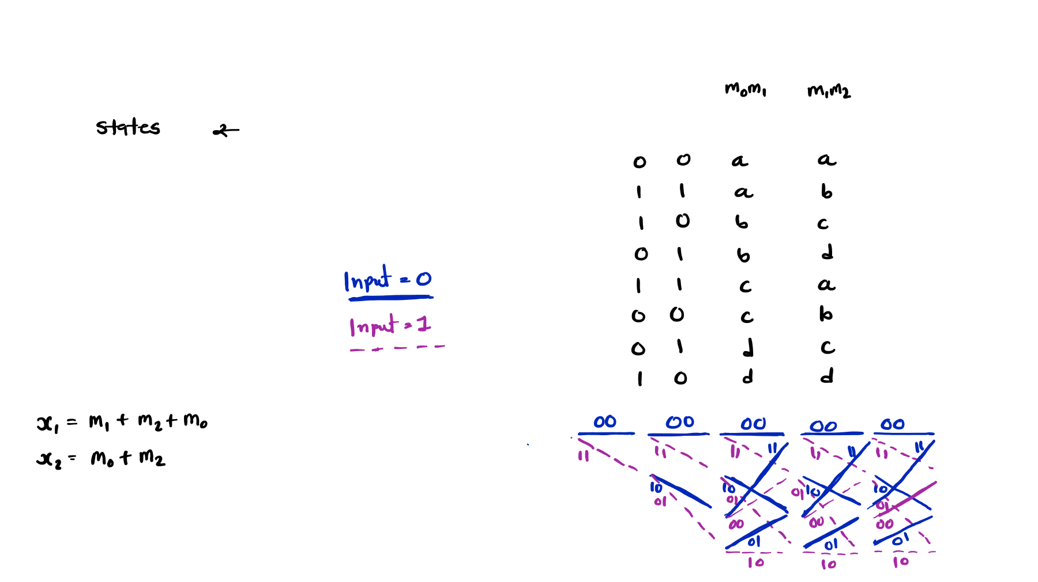








































Example of Viterbi Algorithm
Example: Identify the decoded data using the Viterbi Algorithm if the received bit sequence is 01 10 11 00 00.
Input
M0 | M1 | M2 | X1 | X2 | Current State | Next State
0 | 0 | 0
0 | 0 | 1
0 | 1 | 0
0 | 1 | 1
1 | 0 | 0
1 | 0 | 1
1 | 1 | 0
1 | 1 | 1
M0 | M1 | M2
X1
Outputs
X2
State a [00]
State b [01]
State c [10]
State d [11]

Slide 10
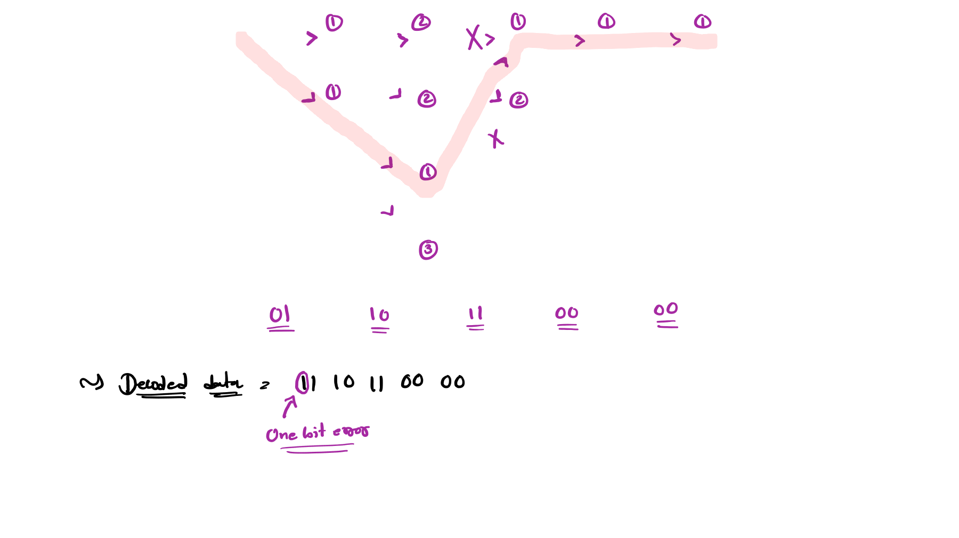

























00 00 00 00 00
11 11 11 11 11
Input 0
State a [00]
Input 1
State b [01]
11
00
11
00
11
00
10
10
10
10
State c [10]
01 01 01 01 01 01 01
State d [11]
10
10
10

